Slide 1
Climate Action Plans – Best Practices
California AEP Annual Conference
March 26, 2018
Rich Walter, Senior Fellow, ICF International
Michael Hendrix, Associate, LSA
on behalf of AEP Climate Change Committee

Slide 2
Best Practices – CAP Implementation
AEP Climate Change Committee White Paper Progress to Date
CAPs and General Plans
Reduction Measures
Tracking, Monitoring and updating mechanisms
CEQA Tiering mechanisms
Legal challenges

Slide 3
AEP White Paper
Provide a Review and Statistical Analysis of Climate Action Plans Throughout California (1,200 CAPs )
Refined sample Population (100 CAPs)
Focus on Qualified Climate Action Plans (60 CAPs)
Provide In-depth Analysis of 9 Climate Action Plans
Equal distribution between Northern California and Southern California
Equal distribution between urban, suburban, and rural communities
Representation of both coastal and inland communities
Representation of rural mountain community
Two county CAPs

Slide 4
AEP White Paper
Provide In-depth Analysis of 9 Climate Action Plans
City of San Diego CAP (Urban So Cal coast)
City of Paso Robles CAP (rural central coast)
County of Marin CAP (Northern California County)
City of Emeryville (Suburban Northern California coast)
City of Murrieta (Southern California suburban inland)
County of Mono CAP (Rural Central California inland mountain community)
City of San Francisco CAP (urban Bay Area)
City of Hesperia CAP (High Desert suburban community)
City of Walnut Creek CAP (Suburban Bay Area community)

Slide 5
Surprises in the Review
Just because a CAP is not “Qualified” does not mean they are not effective.
Example: City of Arcata CAP
Adopted without CEQA review in 2006 with a Reduction goal of 20% below year 2000 levels by 2012.
Committed to updating Inventories every five years
2011 Inventory indicated achievement of the 2012 reduction target
2016 inventory update indicates that the City surpassed an AB 32 compliant 2020 Reduction Target if Arcata had adopted one, which they have not.

Slide 6
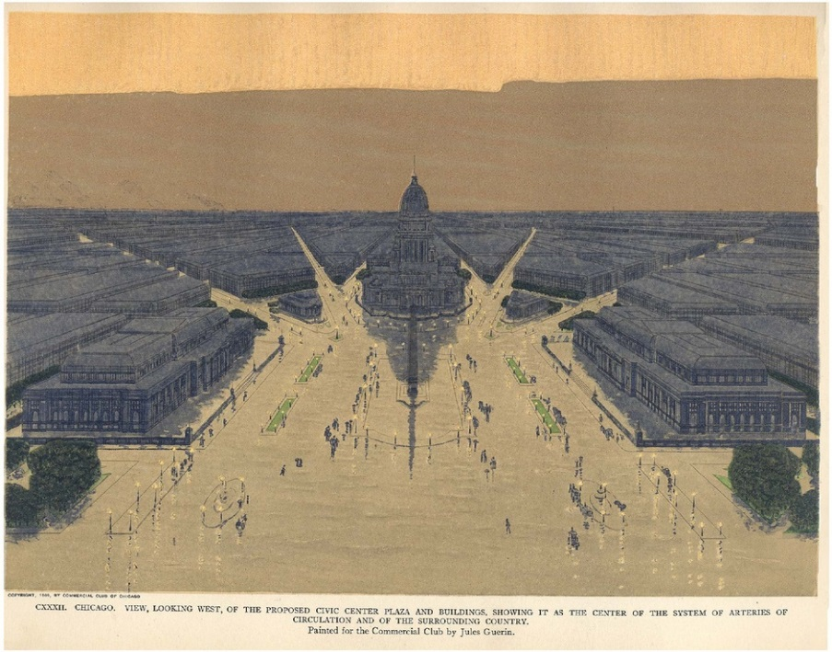
CAPs and General Plans
Option 1: Combine GP and CAP
Advantages: Consistency; land use strategies; CEQA
Disadvantages: CAP revisions must be GP revisions
Option 2: GP and CAP at the same time, but not together
Advantages: Consistency; land use strategies; CEQA; CAP not in GP
Disadvantages: Larger process, potential for more controversy
Option 3: CAP as mitigation measure for GP
Advantages: GP not embroiled in CAP details and issues
Disadvantages: Lack of consistency; separate CEQA for CAP
Option 4: CAP and GP at separate times
Advantages: GP not embroiled in CAP details and issues
Disadvantages: Lack of consistency; separate CEQA for CAP

Slide 7
GHG Reduction Measure Formulation
Voluntary vs mandatory measures
There has been a long-standing debate about whether CAPs should only consist of mandatory measures or should include voluntary measures as well.
Mandatory measures
Mandatory measures easier to defend as certain.
Air Districts, coming from a regulatory perspective, have preferred mandatory measures, as have environmental advocacy groups.
New development can readily be addressed through mandates in code and CEQA mitigation.
Mandatory measures for existing development controversial

Slide 8
GHG Reduction Measure Formulation
Voluntary measures
Voluntary measures can be very effective
Utility-supported energy efficiency retrofits
State and federal alternative fuel vehicle support
Solar incentives
But difficult to guarantee specific results
Market conditions and consumer preference difficult to predict.
Voluntary measures need to be monitored closer than mandatory ones.
Contingent actions in case do not achieve desired results

Slide 9
GHG Reduction Measure Formulation
New development vs built environment
New development subject to approval and CEQA conditions and mitigations.
But existing development larger source of emissions in any inventory
Usually impossible to meet GHG reduction targets on the back of new development only and unfair to impose burdens on new development only.
A balanced approach necessary to meet more ambitious 2030 (and later 2050)
A truth of climate action planning is that we will be retrofitting nearly all existing buildings one or more times to meet long-term goals.

Slide 10
Turning it Up to 11: New Reduction Strategies for 2030
Fuel Switching for Natural Gas
Ramping up Energy Efficiency Retrofits
Point of Sale upgrades?
Zero Net Energy Buildings
Community Choice Aggregation
EV infrastructure
Expanded role for GHG offsets
Role for Air Districts?

Slide 11
The 2050 Reduction Challenge
Efficiency
All older buildings would either have to be demolished, retrofitted, or built new to very high efficiency standards.
Vehicles of all sorts would need to be made significantly more efficient.
Industrial processes would need to advance beyond technology available today.
Source for summary: Greenblatt & Long (2013)

Slide 12
The 2050 Reduction Challenge
Electrification.
Widespread electrification
Hybrid or all-electric vehicle drivetrains,
Heat pumps for space and water heating, and specialized electric heating technology (microwave, electric arc, etc.) in industrial applications.
Source for summary: Greenblatt & Long (2013)

Slide 13
The 2050 Reduction Challenge
Low carbon electricity.
Combinations of low-GHG nuclear energy, fossil fuels with carbon capture and sequestration, and renewable energy.
Emissions from balancing supply and demand at all temporal and spatial scales also need to be considered
Low carbon fuels.
As much of the demand for fuel as possible must be met with sustainably-produced, low net lifecycle GHG biofuels.
Source for summary: Greenblatt & Long (2013)

Slide 14
The 2050 Reduction Challenge
All of the above and one or more of the following more aggressive strategies:
Widespread use of carbon capture and storage
Nuclear power
Mass increase in biomass use with no land use net emissions for transportation and /or electricity
Deep and widespread behavior change
Widespread hydrogen fuel produced from net neutral carbon sources (fossil fuel with CCS, nuclear, etc.)
Source for summary: Greenblatt & Long (2013)

Slide 15
The 2050 Reduction Challenge
Key Challenges to Resolve
Load balancing becomes a larger and larger issue with more intermittent sources in the electricity portfolio.
Unproven CCS technology.
Land use and food prices impacts of biomass fuel expansion.
Nuclear power has no realistic political future in California
Technological and market absorption rates.
Substantial behavior change is never easy.
Source for summary: Greenblatt & Long (2013)

Slide 16
Monitoring, Tracking and Updating
A CAP must be fed and watered to thrive
Monitoring:
Best CAPs have an annual inventory
But many jurisdictions are waiting 5 years or more to inventory emissions
There is a role for ARB or Air Districts to prepare jurisdictional inventories more efficiently on annual or biannual basis to help cities and counties.
Tracking
Annual reporting on progress to City Council/Board of Supervisors
Quantitative assessment of measure progress is best.
Updating
If monitoring or tracking indicates certain strategies are not working as expected, then need to modify strategy, ramp up other strategies or add new strategies.

Slide 17
CEQA Tiering (is not a Jenga move)
Qualified CAPs can provide CEQA tiering
CEQA Guidelines 15183.5 describes “qualified CAP”
Most common approach is to develop CAP Consistency Checklist
Lists all CAP measures
Project review
Evaluates applicability of CAP measures to project.
Evaluates consistency with applicable CAP measures
Checklist used as evidence of consistency for CEQA purposes.
Some jurisdictions (like San Francisco) don’t quantify GHG emissions, and just use a consistency review
Some CAPs have used quantitative metrics from CAP
Example: Screening table approach from San Bernardino County CAP

Slide 18
Court Challenges to CAPs
San Diego County I
San Diego County II
Sonoma County
SF Warriors Arena

Slide 19
San Diego County, Round 1
2011: County adopts a General Plan Update with Mitigation Measure CC-1.2 to adopt a CAP to mitigate significant GHG emissions
2012: County adopted CAP. Sierra Club challenges CAP under CEQA.
Superior Court found CAP did not meet the GP Mitigation Measure requirement and Appellate Court affirmed.
Key issue: enforceability of the CAP GHG reduction measures

Slide 20
CAP Enforceability: Best Practices
How much information must CAP measures have?
If a CAP is to fulfill a CEQA mitigation commitment (such as from an EIR for General Plan Update), then it must meet all of CEQA mitigation requirements.
Why: state the objective of the mitigation measure and why it is recommended.
What: Explain the specifics of the mitigation measure and how it will be designed and implemented.
identify measurable performance standards by which the success of the mitigation can be determined.
provide for contingent mitigation as appropriate if monitoring reveals that the success standards are not satisfied
Who: Identify the agency, organization or individual responsible for implementing the measure.
Where: Identify the specific location of the mitigation measure
When: Develop a schedule for implementation
What level of commitment must CAP measures have?
CAP measure must be a commitment of the lead agency, not a recommendation.
Lead agency must have a plan of implementation, including consideration of funding.

Slide 21
San Diego County, Round 2
Sierra Club, Center for Biological Diversity, Cleveland National Forest Foundation, Climate Action Campaign, Endangered Habitats League, Environmental Center of San Diego, and Preserve Wild Santee vs. County of San Diego

Slide 22
San Diego County, Round 2
New CAP
Revised CAP adopted in February 2018
CAP includes Strategy T-4.1: Establish a Direct Investment Program
Includes working with SDAPCD to implement a carbon offset program, establish an independent registry, or join an existing registry using existing approved protocols.
Strategy Includes funding/implementing projects and registering them.
Separate Mitigation Measure M-GHG-1
Allows use of offsets address GHG emissions for new projects that require a General Plan Amendment to allow density above the 2011 General Plan Update.
Priority for GHG reductions:
Project design features/on-site reduction measures
Offsets within the unincorporated County first..
Then in the County as a whole…
Then in the State of California…
Then in the United States…
Then anywhere in the world.

Slide 23
San Diego County, Round 2
Sierra Club et al Allegations
GHG Offsets:
Lack of standards for offsets sufficient to ensure that GHG reductions will be real and additional to any reductions that might otherwise have occurred.
Determination of offset suitability made after project approval which could mean that inadequate mitigation is identified at the time of project approval.
Offsets outside the County or the United States may be difficult to verify and enforce.
GHG reductions in County have benefits that GHG reductions outside of County don’t and this should have been assessed.
The 2018 CAP is not consistent with County General Plan goals and policies making the General Plan inconsistent. Sierra Club et al assert that the policies call for in-County GHG reductions and improvements not out of County.
Enforceability
County has not committed to selection of programs and projects, deadlines, milestones for funding, or performance measures for Measure T-4.1 (Direct Investment Program). Feasibility should have assessed before CAP adoption.
Other allegations as well, but these two are the primary GHG issues

Slide 24
San Diego County, Round 2
Key Questions re: GHG Offsets
Can GHG offsets be used as measure in a CAP?
Can GHG offsets be used as a CEQA mitigation measure?
What standards should be used for GHG offsets as mitigation?
Under CEQA, does one have to analyze the non-GHG environmental impacts, of foregoing locally/regionally/California GHG reductions vs. GHG reductions outside these jurisdictions?

Slide 25
GHG Offsets and CAPs
Can GHG offsets, including from outside the region or California, be used as measure in a CAP?
Yes!
GHG emissions are widely dispersed into the atmosphere and their impact is on global atmospheric concentrations of GHGs and the resultant change in the planetary radiative balance (aka global warming). This is a global environmental effect, meaning that global reductions of GHG emissions will reduce the global effect of local GHG emissions.
GHG offsets must meet stringent performance standards to be real.
Recommend GHG offsets be allowed only after feasible on-site/project direct reductions.
Recommend requiring consideration of feasibility of local, then regional, then California and only if not feasible/available then elsewhere.

Slide 26
GHG Offsets and CEQA
Can GHG offsets, including those from outside the region or California, be used as a CEQA mitigation measure?
Yes! (But check with your CEQA counsel…)
Global GHG reductions have nexus to the global effect of project’s GHG emissions.
CEQA documents analyze project effects on all other required subjects separate from GHG analysis.
Mandating local or regional only mitigation could result in unwarranted additional cost to projects, if local offsets are substantially more expensive or not readily available than more distant offsets.
GHG offsets must meet stringent performance standards to be real.
Recommend GHG offsets be allowed only after feasible on-site/project direct reductions.
Recommend requiring consideration of feasibility of local, then regional, then California and only if not feasible/available then elsewhere.

Slide 27
GHG Offsets: Performance Standards
Real
Additional
Permanent
Verified
Enforceable

Slide 28
GHG Offsets and CEQA Analysis
Under CEQA, does one have to analyze the non-GHG environmental impacts, of foregoing locally/regionally/California GHG reductions vs. GHG reductions outside these jurisdictions with offsets?
CEQA documents analyze project effects on all other required subjects separate from GHG analysis, so there are no project-related impacts locally or regionally not disclosed.
The implementation of GHG offsets outside the region or California does not result in an impact regionally or in California above baseline conditions.
Instead this is a foregone regional/state benefit but a foregone benefit is not a CEQA impact above baseline conditions.
Recommend disclosing this in CEQA documents.

Slide 29
Sonoma County CAP
Sonoma County Climate Action Plan EIR was challenged by California Riverwatch:
Plaintiff: GHG inventory should include Sonoma County visitor travel emissions to the County and global transportation emissions of delivery of Sonoma wine to market.
Reality: GHG inventory followed established inventory protocols
Plaintiff: CAP measures uncertainty due to too much implementation flexibility.
Reality: Measures included performance standards for GHG reductions.
Plaintiff: EIR should have analyzed moratorium on vineyard, winery, and tourist serving development and should not have analyzed offsets.
Reality: Moratorium not consistent with adopted City and County General Plans and thus not feasible and inconsistent with project objectives.
Superior Court ruled in favor of plaintiff; Superior Court ruling not precedent.
Resolution:
“Now, the county will have to amend its plan or start from scratch and create a new one” - lead attorney for River Watch.
Lawsuit settlement: Riverwatch did not require any changes in CAP. EIR decertified (no CEQA tiering). Riverwatch received legal fees.

Slide 30
Golden State Warriors Arena
Mission Bay Alliance v. Office of Community Investment and Infrastructure
Project: The Golden State Warriors new arena complex at Mission Bay south of downtown San Francisco
CEQA document: 2015 supplemental EIR tiered to a 1998 subsequent EIR tiered to the 1990 Mission Bay plan EIR
Court of Appeal upheld the adequacy of the 2015 SEIR:
Substantial evidence supported the SEIR’s key determinations and conclusions
The analysis properly relied on city GHG reduction strategies to conclude that impacts would be less than significant
Qualitative approach and reliance on standards complied with CEQA

Slide 31
Questions

Slide 32
Thanks…and Contact Information
Rich Walter, ICF
Rich.Walter@icf.com
Tel: 510-290-1860
Link to AEP Climate Change Committee White Papers:
https://www.califaep.org/climate-change
Michael Hendrix, LSA
Michael.Hendrix@LSA.net
Tel: 951-236-1896

