Slide 1
Water Quality and Water Rights Roundup
Hot Legal Issues for 2018
S. Wayne Rosenbaum Environmental Law Group LLP
Varco and Rosenbaum
225 Broadway, Suite 1900 San Diego, CA 92101 Phone: (619) 231-5858
Cell: (619) 518-6618 Fax: (619) 231-5853
SWR@Envirolawyer.com
www.envirolawyer.com

Slide 2
Hot Water Rights Issues for 2018
Surface Water Rights
Ground Water Rights
SGMA

Slide 3
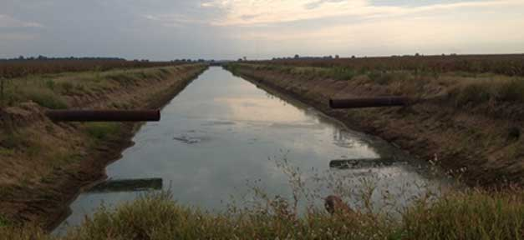
Surface Water Rights in California
Riparian Rights
The highest right (maybe)
The right to use water
On land contiguous to the water course
Smallest tract held under chain of title
Within the Watershed
Reasonable use or correlative right.
Appropriative Rights
First in time – first in right
The right
To appropriate water
For a beneficial use
Not related to a single location
Prescriptive Rights
A permanent right to use water acquired through adverse possession
Open and hostile
Without permission
For the statuary period.

Slide 4
Surface Water Rights in California
Pueblo Rights
San Diego and Los Aneles are successors of Spanish or Mexican pueblos (settlements), and followed claim procedures establishing their pueblo rights.
They possess a paramount right to the beneficial use of all needed, naturally occurring surface and subsurface water from the entire watershed of the stream flowing through the original pueblo.
Pueblo water rights are superior to all riparian and appropriative rights and cannot be lost by a failure to assert an interest or use the water.

Slide 5
Surface Water Rights in California
Federal Reserved Rights
When the United States reserves public land for uses such as Indian reservations, military reservations, national parks, forest, or monuments, it also implicitly reserves sufficient water to satisfy the purposes for which the reservation was created.
The federal reserved water rights doctrine was established by the U.S. Supreme Court in 1908 in Winters v. United States.
An Indian reservation may reserve water for future use in an amount necessary to fulfill the purpose of the reservation, with a priority dating from the treaty that established the reservation.
The first time the federal government deviated from the established convention that water law was purely a state matter.
In 1952, Congress passed the McCarren Amendment
Returns substantial power to the states with respect to the management of water.
Requires that the federal government waive its sovereign immunity in cases involving the general adjudication of water rights.

Slide 6
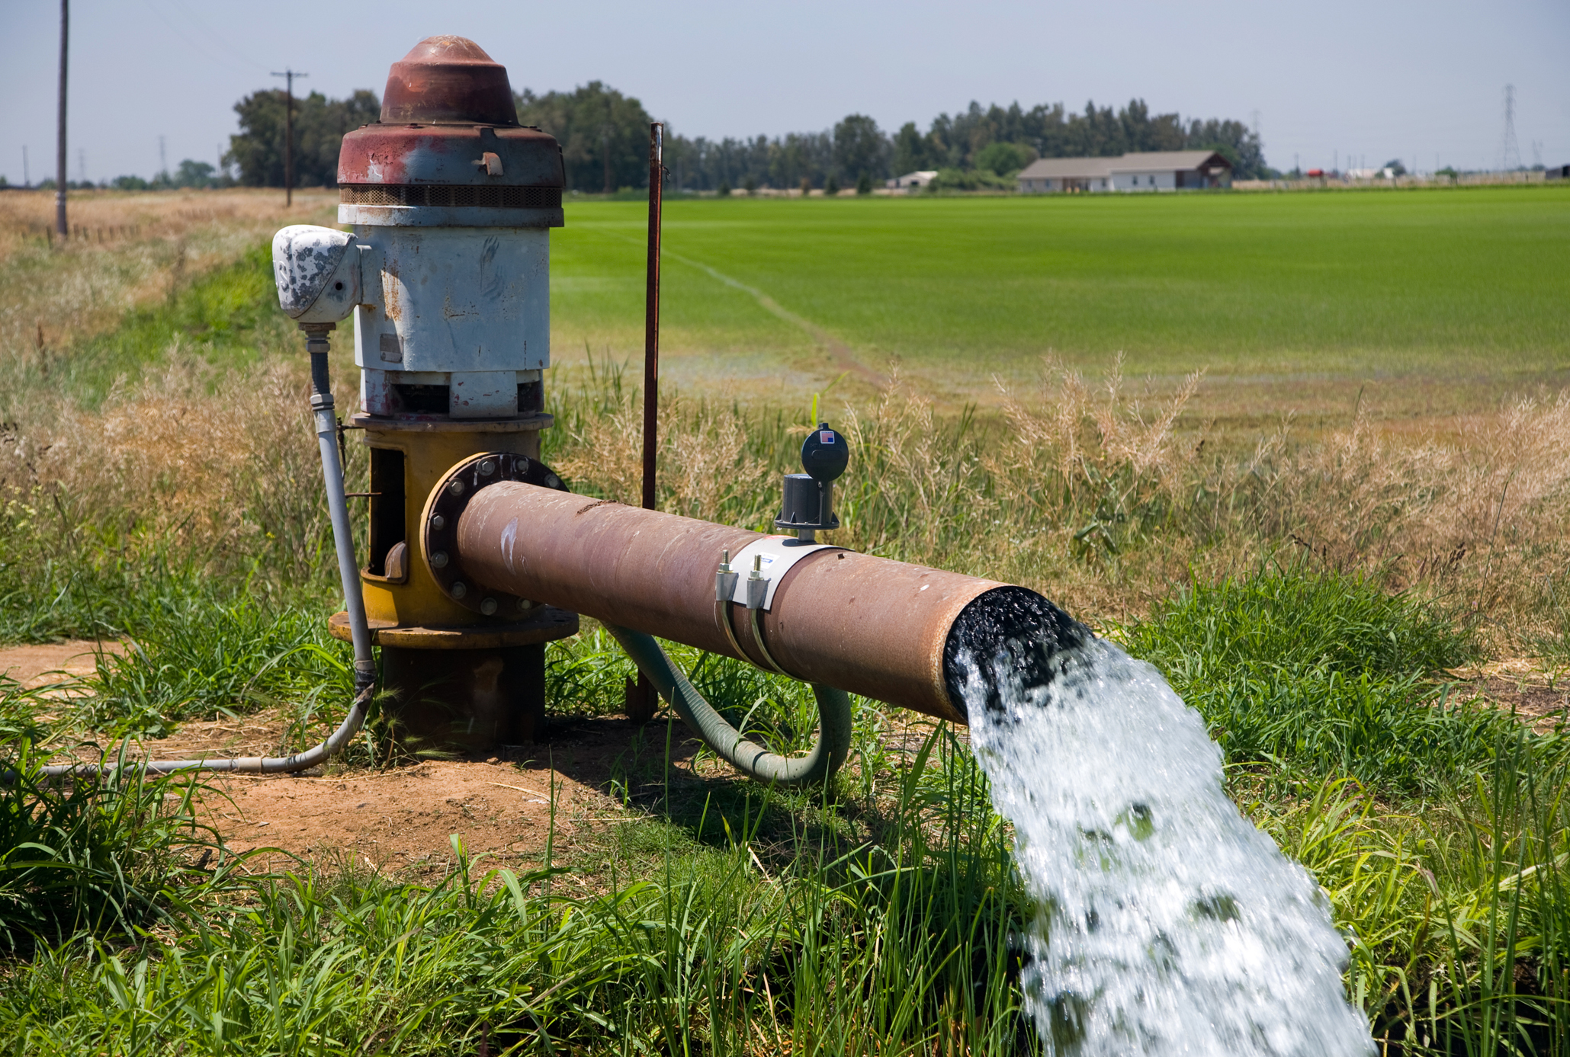
Ground Water Rights in California
Overlying Rights
The riparian right to use ground water
Municipal Rights
An appropriative right to export ground water
Prescriptive Rights
An right to the water through adverse possession
Pueblo Rights
Discussed above
Federal Rights
Discussed above

Slide 7
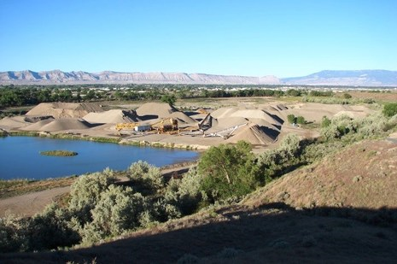
What is SGMA
A package of three bills (AB 1739, SB 1168, and SB 1319) that provides local agencies with a framework for managing groundwater basins in a sustainable manner.
SGMA defines sustainable groundwater management as the management of groundwater supplies in a manner that can be maintained during the planning and implementation horizon without causing undesirable results.
Undesirable results include significant and unreasonable chronic lowering of groundwater levels, reduction of groundwater storage, seawater intrusion, degraded water quality, land subsidence, and depletion of interconnected surface waters.
Attempts to manage a zero sum game.

Slide 8
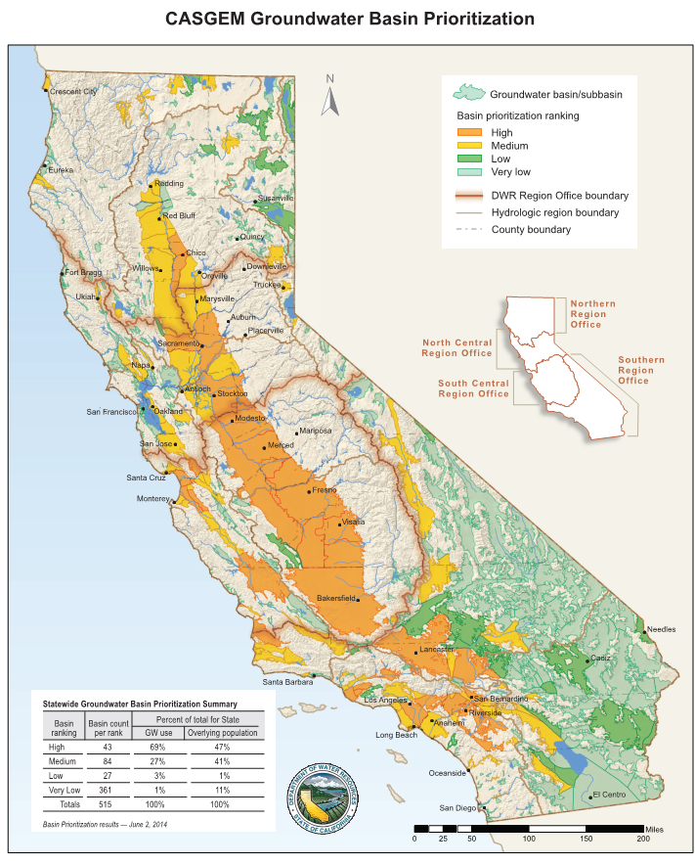
What does the SGMA do?
Respects regional differences and provides for a tailored approach to planning.
Establishes minimum standards for sustainable groundwater management.
Improves coordination between land use and groundwater planning.
Provides state technical assistance.
Creates a mechanism for state intervention if, and only if, a local agency is not managing its groundwater sustainably.
Protects water rights.

Slide 9
How does it do it?
SGMA requires local agencies to establish a new governance structure, known as Groundwater Sustainability Agencies (GSAs), prior to developing groundwater sustainability plans for groundwater basins or sub-basins that are designated as medium or high priority.
The act provides substantial time – 20 years – for GSAs to implement plans and achieve long-term groundwater sustainability.
The Sustainable Groundwater Management Act provides local GSAs with tools and authority to:
Require registration of groundwater wells
Measure and manage extractions
Require reports and assess fees
Request revisions of basin boundaries, including establishing new sub-basins

Slide 10
How does it do it?
GSAs responsible for high- and medium-priority basins must adopt groundwater sustainability plans within five to seven years, depending on whether the basin is in critical overdraft. Agencies may adopt a single plan covering an entire basin or combine a number of plans created by multiple agencies. Preparation of groundwater sustainability plans is exempt from CEQA.
Plans must include a physical description of the basin, including groundwater levels, groundwater quality, subsidence, information on groundwater-surface water interaction, data on historical and projected water demands and supplies, monitoring and management provisions, and a description of how the plan will affect other plans, including city and county general plans.

Slide 11
Formation of Groundwater Sustainability Agencies
SGMA requires, by June 30, 2017, the formation of locally-controlled groundwater sustainability agencies (GSAs) in the State’s high- and medium-priority groundwater basins and subbasins (basins).
If two or more agencies submit GSA notices with overlapping boundaries within a basin, these overlaps must be resolved before a GSA is formed.

Slide 12
SGMA Implementation Timeline
Deadline: | Action:
June 30, 2017 | Formation of Groundwater Sustainability Agencies (GSAs)
January 31, 2020 | Adoption of Groundwater Sustainability Plans (GSPs) Critically Overdrafted Basins (e.g., Borrego Valley)
January 31, 2022 | Adoption of Groundwater Sustainability Plans (GSPs) All Other Basins (e.g., San Diego River, San Luis Rey, San Pasqual)
20-Year Implementation Period | Implementation of Groundwater Sustainability Plans (GSPs)

Slide 13
Potential Conflicts
Integration of surface and ground water rights
Urban Runoff
Pueblo Rights
Augmentation schemes
Beneficial uses
Is there a hierarchy
Environmental Protection vs Beneficial Uses
Federal participation

Slide 14
Water Quality Basics
Surface Water
Process Water
Stormwater Capture and Reuse
Comingled systems

Slide 15
Hot Water Quality Issues for 2018
Changes to the Storm Water Standards Manual
Construction Permit Interpretations
Industrial Permit Amendments
Liability of Landlords
Jurisdictional Disputes
Groundwater discharges
Reliance on RWQCB decisions
Due Process in RWQCB Enforcement Actions
RCRA liability
TMDLs
Citizen Suits

Slide 16
Changes to Storm Water Standards Manual
All projects will be required to prepare WTAP
No size limitation
No risk level limitation
WTAP Triggers will vary based on inspector’s subjective opinion of site compliance
5 Levels of compliance
Most compliant
Trigger 50% chance of rain
WTAP prepared 48 hours prior to rain
WTAP implemented prior to commencement of rain
Least compliant
Trigger 30% chance of rain
WTAP prepared 72 hours prior to rain
WTAP implemented 36 hours prior to commencement of rain.

Slide 17
Changes to Storm Water Standards Manual
Expanded scheduling for projects disturbing more than ten acres
BMP implementation schedule must be approved prior to issuance of grading permit.
Schedule must identify specific BMPs that will be deployed at each “phase, transition, or significant milestone within phases”.
Prepared by a QSD

Slide 18
Construction Permit Interpretations.
Risk Level 2 dischargers shall provide effective soil cover for inactive areas and all finished slopes, open space, utility backfill, and completed lots.
Inactive areas of construction are areas of construction activity that have been disturbed and are not scheduled to be re-disturbed for at least 14 days.
Cover and berm loose stockpiled construction materials that are not actively being used (i.e. soil, spoils, aggregate, fly-ash, stucco, hydrated lime, etc.).
How to define “actively being used”

Slide 19
Industrial Permit Amendments
TMDLs
TNALs
NELs
Are TNALs and NELs receiving water limitations?
Cost and feasibility of compliance?
Will the RWQCB approve Time Schedule Orders to achieve compliance?
New compliance options
Retain the 85th percentile storm on-site
Retain the 85th percentile storm off-site

Slide 20
Liability of Landlords
Two district courts within the Ninth Circuit held that a [landlord] may be liable under the CWA for unlawful storm water discharges associated with industrial activities if the [landlord] exercises sufficient control over a facility that discharges unlawful pollutants, even if the [landlord] did not create the discharges. California Sportfishing Protection Alliance v. The Shiloh Group WL 3136443, --- F.Supp.3d --- (2017)

Slide 21
Jurisdictional Disputes
Who has enforcement authority as between Phase I and Phase II MS4s?
MTS
Fairgrounds
Others

Slide 22
Groundwater Discharges
Hawai’i Wildlife Fund v. County of Maui 9th Circ. February 1, 2018
County of Maui violated the Clean Water Act when it discharged pollutants from its wells into the Pacific Ocean
County’s four discrete wells were “point sources” from which the County discharged “pollutants” in the form of treated effluent into groundwater, through which the pollutants then entered a “navigable water,” the Pacific Ocean.
Clean Water Act does not require that the point source itself convey the pollutants directly into the navigable water

Slide 23
Reliance on RWQCB Decisions
California Sportfishing Protection Alliance v. The Shiloh Group WL 3136443, --- F.Supp.3d --- (2017) in which the District Court refused to take judicial notice of a Notice of Termination of permit coverage by the Regional Water Quality Control Board

Slide 24
Due Process in RWQCB Enforcement Actions
Point Buckler Club, LLC v. California Regional Water Quality Control Board , San Francisco Bay Region (Superior Court County of Solano, December 27, 2017) in which the Court concluded that
the Regional Board's conclusory statement of need was not sufficient to require a report under Water Code section 13267,
that the agency did not provide a fair trial,
that the agency violated the due-process prohibition on vindictive prosecution,
and that the penalties were excessive fines in violation of the Eighth Amendment.
The Clourt’s decision is likely applicable to jurisdictions.

Slide 25
RCRA Liability
Ecological Rights Foundation v. Pacific Gas Electric Company, No 15-15424 (9th Cir. November 2, 2017)in which the court held that storm water discharges from facilities that are not subject to Storm Water Permits are “solid wastes” subject to enforcement under RCRA.
Sites less than an acre

Slide 26
Construction TMDLs
TMDLs will be included in the next iteration of the construction permit.
Likely to expand the pollutants of concern that will need to be tested for.
Likely to include enforceable Numeric Effluent Limitations

Slide 27
Citizen Suite Statistics
Number of Notices of Intent to Sue over the last 12 months 250
Top four litigants
Brodsky law firm – 66
California River Watch – 26
CERF – 17
LA Waterkeeper – 16

Slide 28
Citizen Suite Settlement Demands
Money
Legal fees $40,000 to $100,000 without litigation
Fund an environmental project $5,000 to $50,000
Defense Costs $5,000 to $50,000 without litigation
Injunctive relief
Comply with the permit including meet California Toxic Rule discharge limitation at point of discharge without dilution.

Slide 29
In a Nut-Shell – Implications For
Property Owners
Liability for tenants
Business Owners
Liability for commercial businesses
Permittees
Numeric Effluent Limits and Strict Liability
Property Managers
Personal Liability as the LRP

Slide 30
Questions?

